Slide 1
COMPETENCY BASED ASSESSMENT FRAMEWORK
A PAPER PRESENTED DURING
SENIOR SCHOOL TEACHERS RETOOLING
AUGUST 2025

Slide 2
Session Outcomes
By the end of the session, the participants should be able to
  explain the meaning of CBA
  explain the rationale behind the shift in assessment modes under Competency Based Education (CBE)
  Understand the theoretical foundations that underpin CBA
  describe the linkage between Competency-Based Curriculum (CBC) and CBA
  explore the CBA Framework
  discuss the Paradigm shifts in assessment practices associated with CBE

Slide 3
Activity 1
1. What is a competency?
2. Can you recall a moment during your time as a student when you felt a teacher may not have demonstrated competency?
If so, how did that experience affect your learning?
Invite a few randomly selected participants to briefly share their personal experiences

Slide 4
Competency
Is the ability to apply appropriate knowledge, skills, values and attitude to successfully perform a real-life task
Example
A senior school science teacher can demonstrate competency by:
  Applying subject knowledge to explain concepts clearly using relevant examples.
  Using instructional skills to engage learners through experiments and discussions & fieldwork aligned with CBC
  Showing professional values by respecting learners’ diverse backgrounds and learning needs across urban and rural settings
  Maintaining a positive attitude that fosters curiosity, resilience, and a growth mindset among learners.
  Successfully managing a classroom and adapting lessons to real-world scenarios

Slide 5
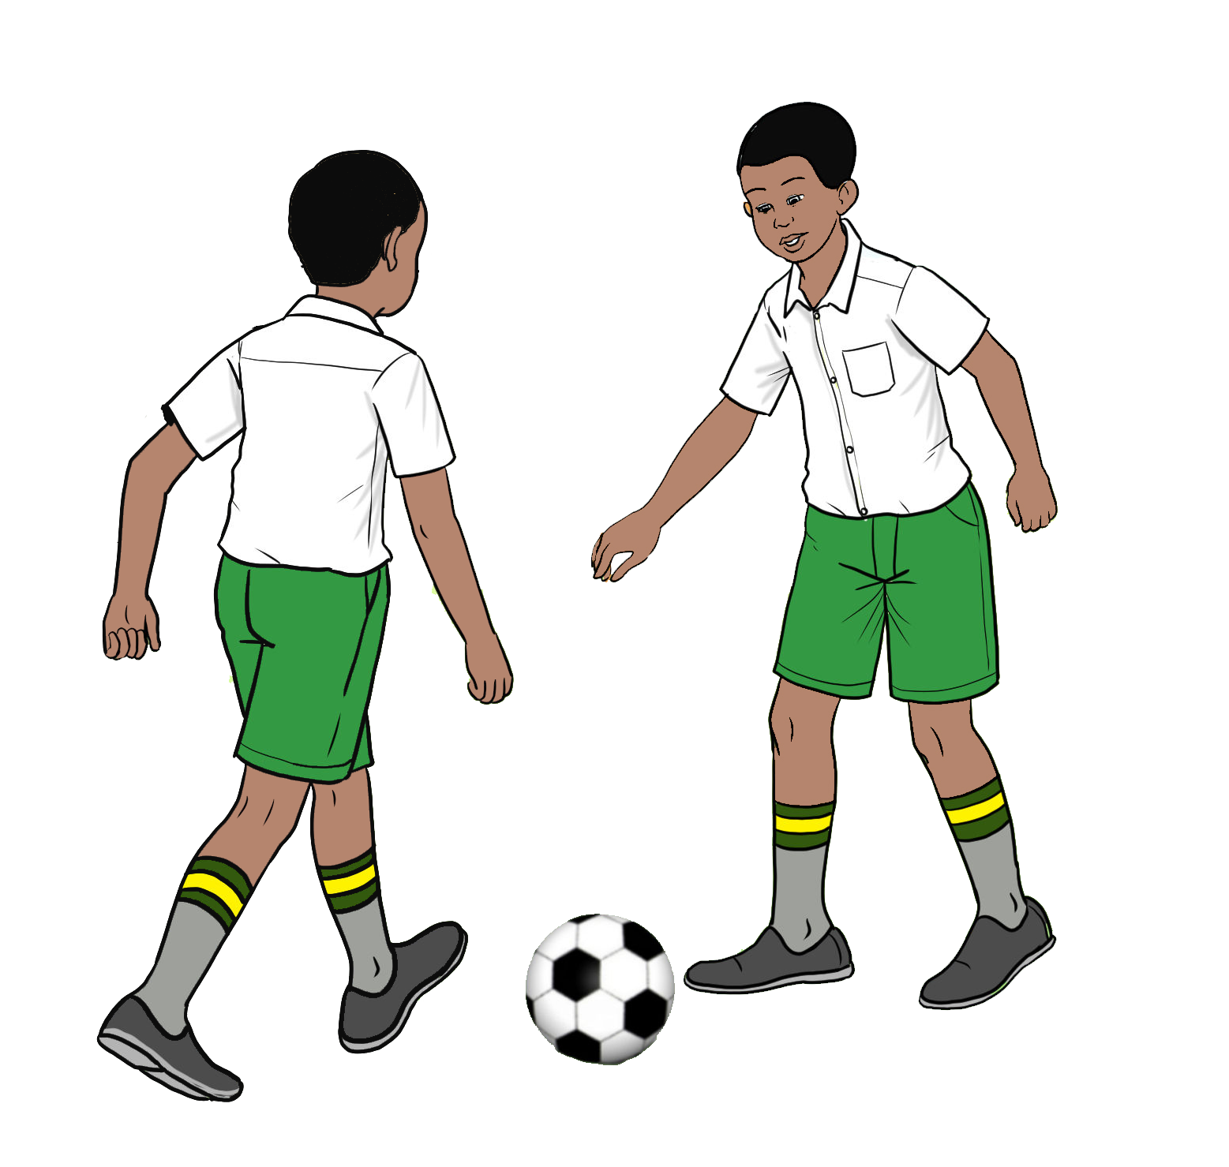


(a) What is CBA?
  Is the process of assessing a learner’s ability to apply knowledge and skills in real or meaningful contexts
  Involves intentional process of collecting credible evidence and making informed judgments about what a learner understands and can do.
  carried out using a variety of tools and methods, including written tests, projects, and practical activities, to capture diverse aspects of learning

Slide 6

Therefore;
CBA is a continuous process that focuses on documenting what a learner knows and can do:
Before learning – to identify prior knowledge and readiness
During learning – to monitor progress and guide instruction
After learning – to assess mastery of skills and to inform transition

Slide 7

(b)Rationale behind the shift in assessment modes
Reduce
exam-centric pressure on learners:
Uses both formative & summative assessments
Emphasize
practical skills and real-world application: Bridges the gap between school and world of work, making learner to thrive and not to survive.
Promote
equity and inclusivity ensuring that no one is left behind due to rigid timelines or standardized examinations
Align
with global best practices in assessment- to ensure education system remains relevant and competitive globally
Prepare
learners for 21st-century skills & challenges: current world demands skills such as; collaboration, communication digital literacy, lifelong learning; adaptability skills that traditional exams rarely assess.

Slide 8
(c)Theories Underpinning Competency-Based Assessment in Kenya
Theory | Major Assertions | Implications for Assessment
Experiential Learning (Kolb) | Learning is best through experience and reflection. | Use of fieldwork, experiments/practical, role plays, and projects.
Situated Learning (Lave & Wenger) | Learning is social and context-bound. | Design authentic, real-world tasks and collaborative assessments.
Multiple Intelligences (Gardner) | Learners have diverse intelligences (e.g., linguistic, spatial, kinesthetic). | Use varied assessment tools to capture different strengths.
Constructivist Theory (Piaget, Vygotsky) | Learners construct knowledge through interaction and exploration. | Encourage formative assessment, scaffolding, and learner reflection.
Bloom’s Taxonomy | Learning progresses from remembering to creating. | Design assessments that target higher-order thinking skills.
Social Learning Theory (Bandura) | Learning occurs through observation and modeling. | Incorporate peer assessment, group work, and role modeling.

Slide 9
(d)The linkage between various components of CBC and CBA
CBC | CBA
Learning outcomes | Assessment standards
Learning Experiences | Assessment Tasks
Assessment Rubrics for Sub strands | Assessment Rubric for Tasks

Slide 10
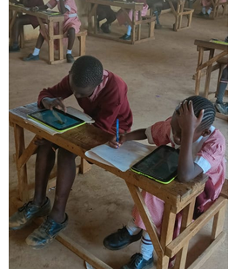
(e) Assessment framework
It is a structured plan that defines the
purpose of assessment,
tools to be used,
modes of delivery,
feedback mechanisms.
It ensures assessments are purposeful, consistent and aligned with specific goals,
provide clear criteria for measuring performance and guiding improvement.

Slide 11
Principles of CBA
Validity
Accurately measures what it intends to measure
Reliability
Consistency in producing identical results
Fairness
Equality, equity and justice
Flexibility
Responsive to needs of the situation and learner
Accessibility
Accommodate all learners
Practicability
Economy of time, effort and cost
Authenticity
Assessment tasks should relate to real life experiences
Sufficiency
Sufficient evidence to reach an assessment decision
Timely feedback
Immediate
Collaboration
Involves self, peer and teacher assessment
Currency
Recognition of current competencies

Slide 12
What types of assessments are administered by KNEC under the CBA framework do you know of?
Activity 3
Invite a few randomly selected participants to briefly share their personal experiences

Slide 13
Organization of CBA Age-Based Curriculum

Slide 16
Organisation of CBA Stage-Based Curriculum

Slide 19
Junior School Assessment structure
Grade 8
(SBA)
20% of SBAs(7,8)
40%
100%
20% KPSEA
Grade 9
Grade 7
(SBA)
20% KPSEA
KJSEA
60% summative

Slide 20
Senior School Assessment structure
Grade 10
(SBA)
SBA30%
100%
30%
Grade 12
Grade 11
(SBA)
KCBE
70% summative

Slide 21

Shifts in Assessment

Slide 22
Activity 2: Shifts in Assessment Practices
What are some of the most noticeable changes in assessment practices in Kenya’s education system?
Invite a few randomly selected participants to briefly share their personal experiences

Slide 23
(f) Paradigm shifts in Assessment Practices
Focuses on Competencies: skills, knowledge &values
Continuous Assessment: learner assessed throughout the learning process.
Authentic Assessment: Assesses the application of knowledge and skills to solve real world problems
Assessment tools: Uses variety of assessment tools to gather information about a learner’s achievement and cater for diverse learner needs and abilities
Integration of ICT in assessment
Learner-Centred: From Teacher-Centered to Learner-Centered Assessment, tailored to meet individual learners’ needs
Holistic Approach in Assessment: Evaluates emotional and social development alongside cognitive achievements.
Formative Feedback: Continuous and constructive feedback to guide learning.

Slide 24

Pillars of Assessment
Refer to components or foundational elements that supports an effective assessment system.
Before conducting any assessment, educators should reflect on key foundational pillars:
1. Purpose – WHY?
2. Mode – HOW?
3. Reporting – WHAT & WHO?
  What is the goal of the assessment?
  Is it for:
    Placement?
    Transition?
    Informing instruction?
  Based on the purpose, choose the appropriate assessment method:
    Project method
    Written test
    Oral assessment
    Practical assessment
    Portfolio
  Determine:
    How learner achievement will be reported.
    Who will receive the feedback (e.g., learners, parents, administrators).
    Which approach will be effective in communicating of results.

Slide 25
CBA Journey and the Key Milestones
KNEC administered Grade 9 PILOT
Conducted Pilot study for Grade 3
Successfully Conducted 4th SBA and the
1st KPSEA &KILEA
KNEC administered 2nd SBA (Grade 3, 4)
Start of CBC implementation
2017
2018
2019
2020
2021
2022
2023
2024
2025
MLP(KEYA)
Conducted the 1st assessment to Grade 3
& KFLEA
Conducted the 3rd assessment (Grade 3,4,5)
KNEC to 1ST administer KJSEA & KPLEA
Successfully Conducted 5th SBA & the 2nd KPSEA &KILEA

Slide 26
HOW SUBJECTS ARE ASSESSED
 | Grade -KPSEA | Junior School-KJSEA | Senior School-KCBE
1 | English | 1. English | English
 |  |  | Literature in English
2 | Kiswahili/KSL | 2. Kiswahili/KSL | Kiswahili
 |  |  | Fasihi ya Kiswahili
 |  |  | Kenyan Sign Language (KSL)
3 | Mathematics | 3. Mathematics | Core Mathematics
 |  |  | Essential Mathematics
4 | Integrated Science (Science & Technology, Agriculture, Home Science, PHE) | 4. Integrated Science | Biology
 |  |  | Physics
 |  |  | Chemistry
 |  |  | General Science
 |  | 5. Agriculture | Agriculture
 |  |  | Home science

Slide 27
5 | Creative Arts & Social studies (Music, Art & Craft, Social Studies & Religious Education-CRE-HRE, IRE) | 6. Social Studies | Geography
 |  |  | History & Citizenship
 |  | 7. CRE/IRE/HRE | CRE/IRE/HRE
 |  | 8. Creative Arts & Sports | Music and Dance
 |  |  | Fine Arts
 |  |  | Theatre and Film
 |  |  | Sports & Recreation
 |  | 9. Pre-technical Studies | Computer Studies
 |  |  | Business Studies
 |  |  | Aviation
 |  |  | Building Construction
 |  |  | Electricity
 |  |  | Metalwork
 |  |  | Power mechanics
 |  |  | Woodwork
 |  |  | Media Technology
 |  |  | Marine and Fisheries Technology
 |  |  | Arabic/French/German/ Chinese Mandarin
 |  |  | Indigenous Language

Slide 28


